Slide 1
Introduction to Metagenome Analysis and Tools in IMG
Emiley Eloe-Fadrosh
eaeloefadrosh@lbl.gov

Slide 2
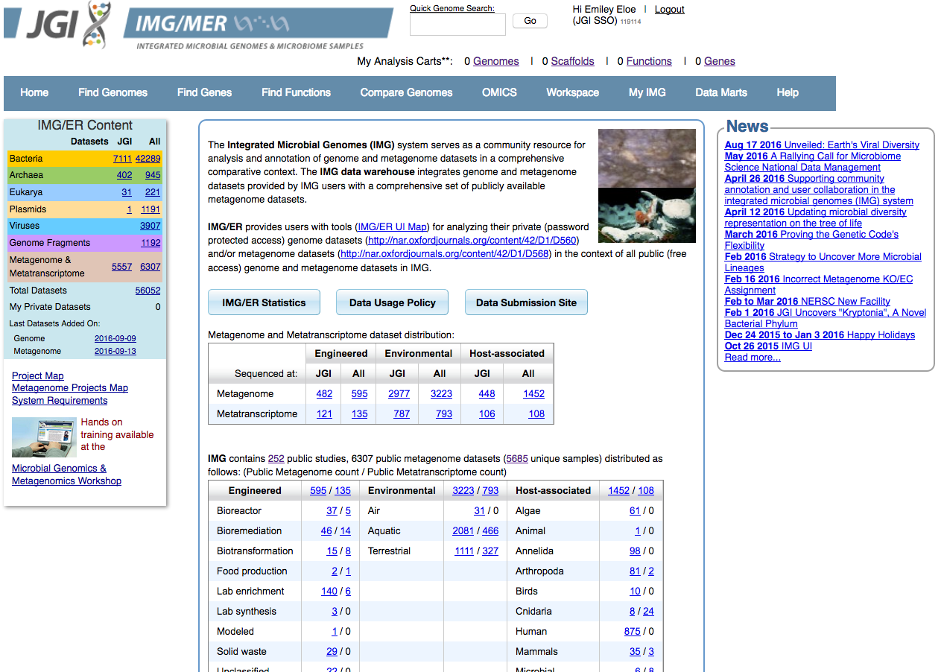
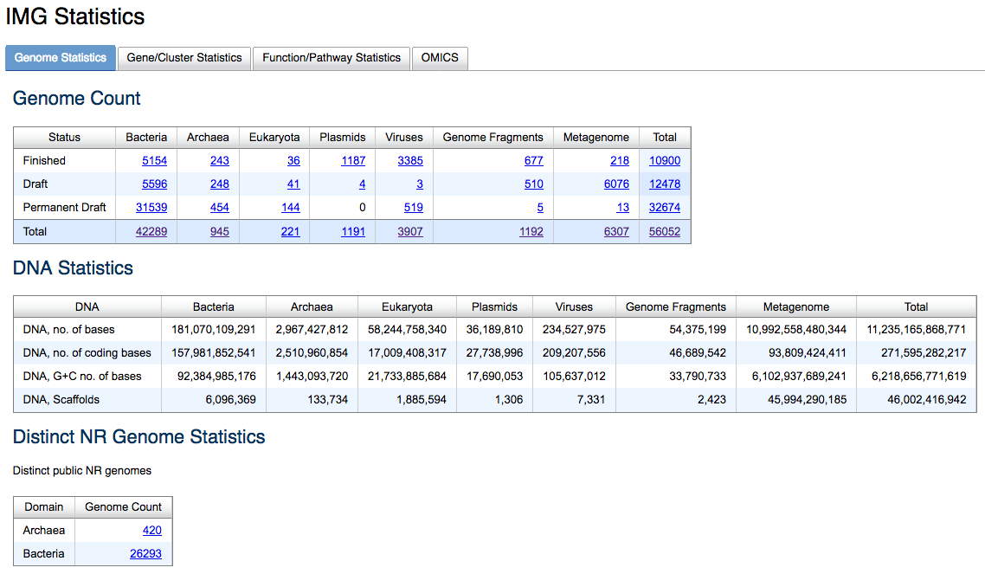
img.jgi.doe.gov
Over 47,000 microbial and viral genomes and 6,000 metagenomes

Slide 3
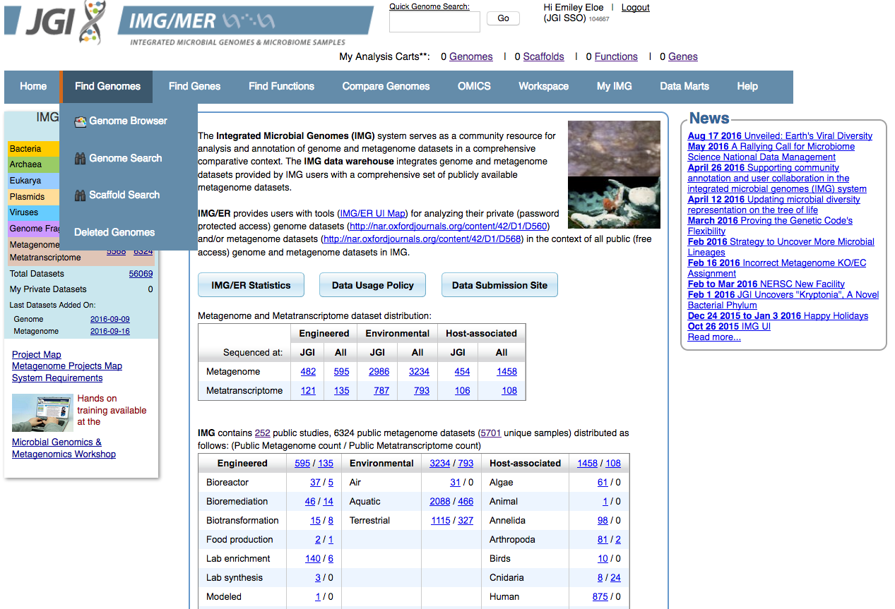
img.jgi.doe.gov
Find (meta)Genomes Tab:
Explore metagenomes by environmental metadata categories
Search by specific metadata filters (e.g. NCBI Taxon ID, Study name)
Fine-tune search by applying multiple metadata categories/filters
Explore metadata category charts

Slide 4
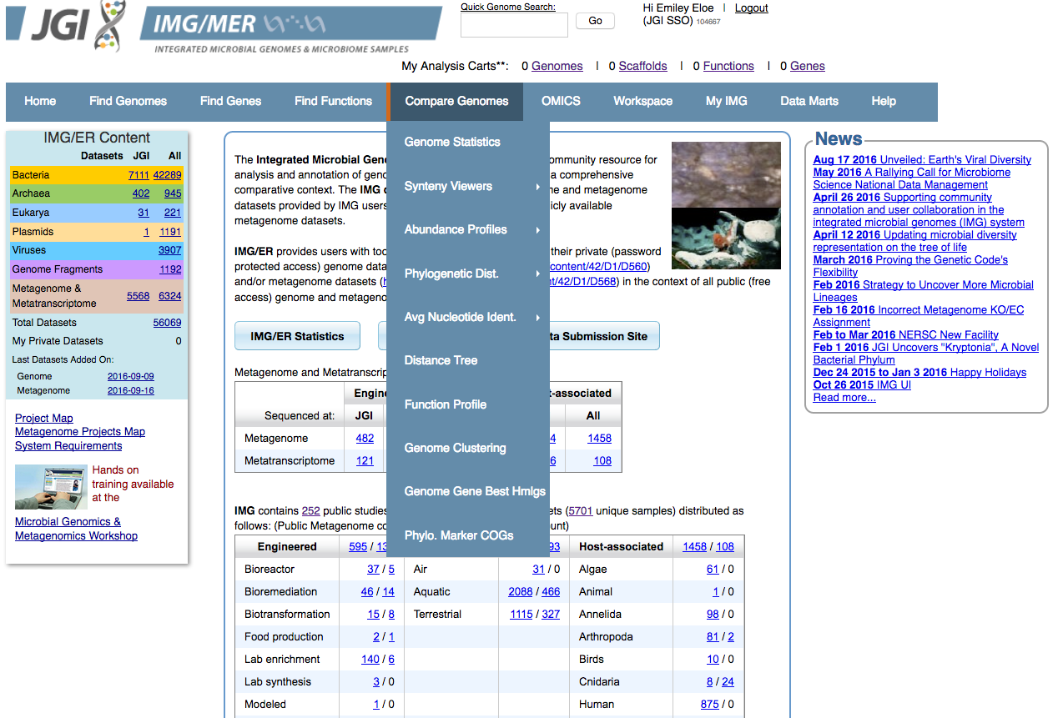
img.jgi.doe.gov
Compare (meta)Genomes Tab:
Compare functional profiles across metagenomes
Phylogenetic distribution of metagenomes
Visualize differences across metagenomes

Slide 5

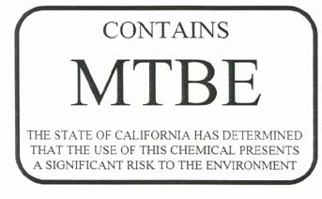
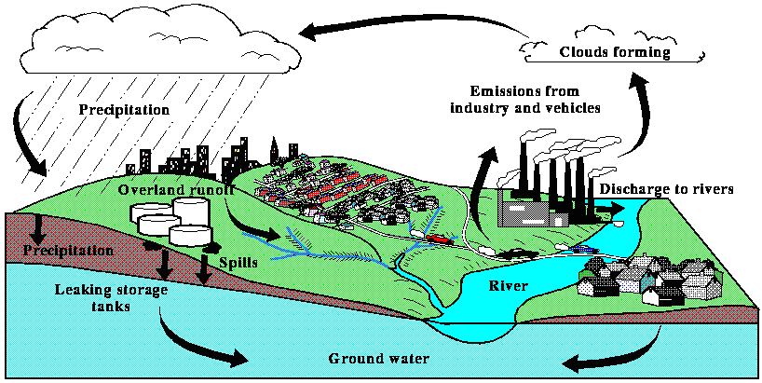
Case Study: Methyl tert-butyl ether (MTBE)

Slide 6
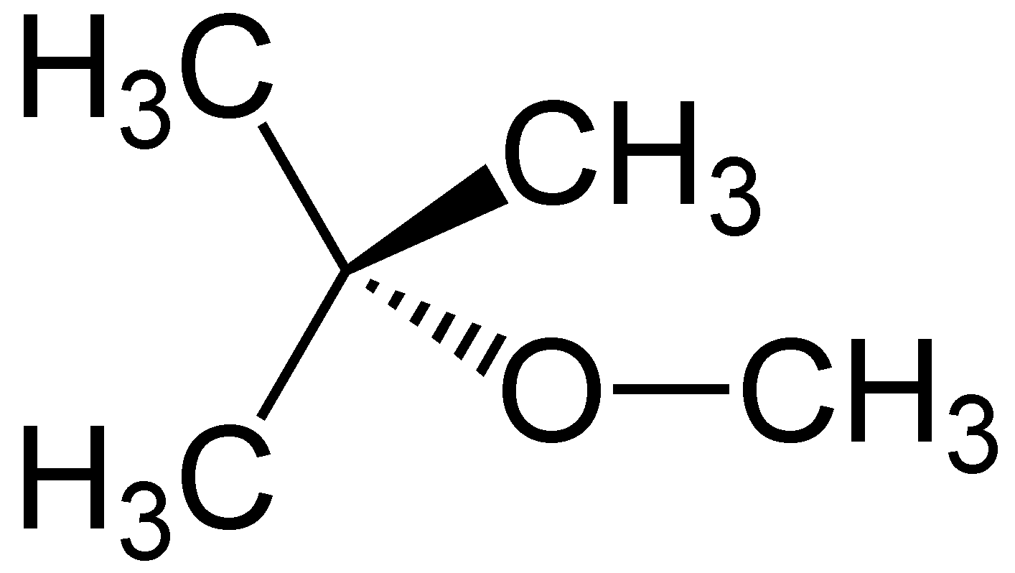
Anaerobic degradation of MTBE
Hypothesis:
Long-term MTBE contamination will enrich for anaerobic microbial communities capable of utilizing MTBE for carbon and energy
?
Little is known about the microbial species that can utilize MTBE or the anaerobic degradation mechanisms
Likely includes acetogenic bacteria coupled with methanogens or sulfidogens

Slide 7
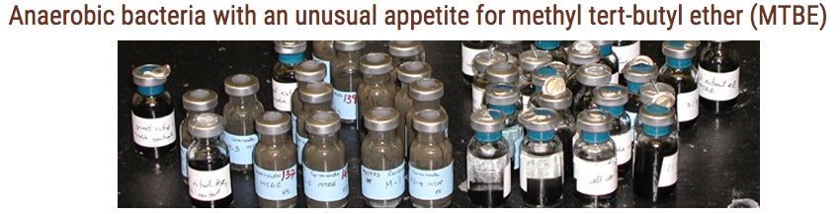


Anaerobic degradation of MTBE
Sediment methanogenic enrichment culture
IMG Taxon ID: 3300005144
Sediment sulfidogenic enrichment culture
IMG Taxon ID: 3300005254

Slide 8
Anaerobic degradation of MTBE
Objectives:
Explore methanogenic enrichment metagenome
Overview of metagenome
Phylogenetic distribution of genes
Functional profile using KEGG
Are functions for acetogenesis and methanogenesis present?
Compare methanogenic and sulfidogenic enrichments
Phylogenetic and functional differences

Slide 9
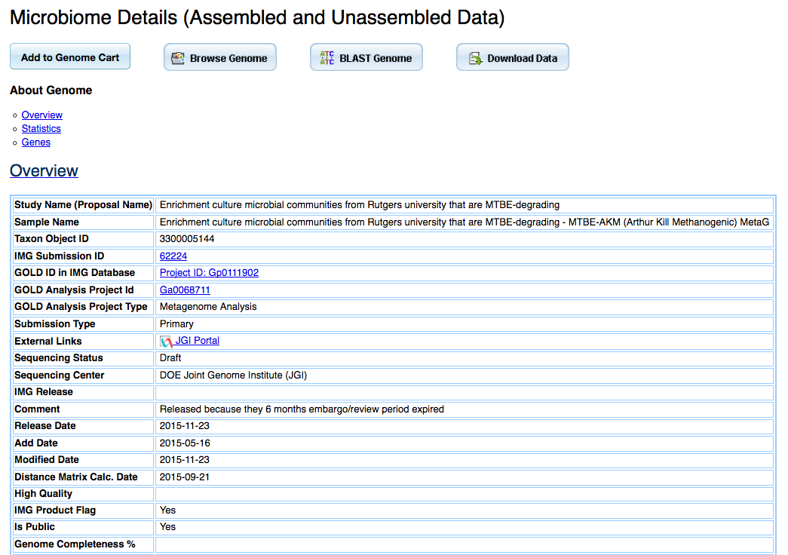
Live Demo
Explore Methanogenic Enrichment Metagenome (IMG Taxon ID: 3300005144)
Quick Genome Search
Link out to GOLD metadata: GOLD Project ID, GOLD Analysis Project ID
Link out to JGI Portal for data download

Slide 10
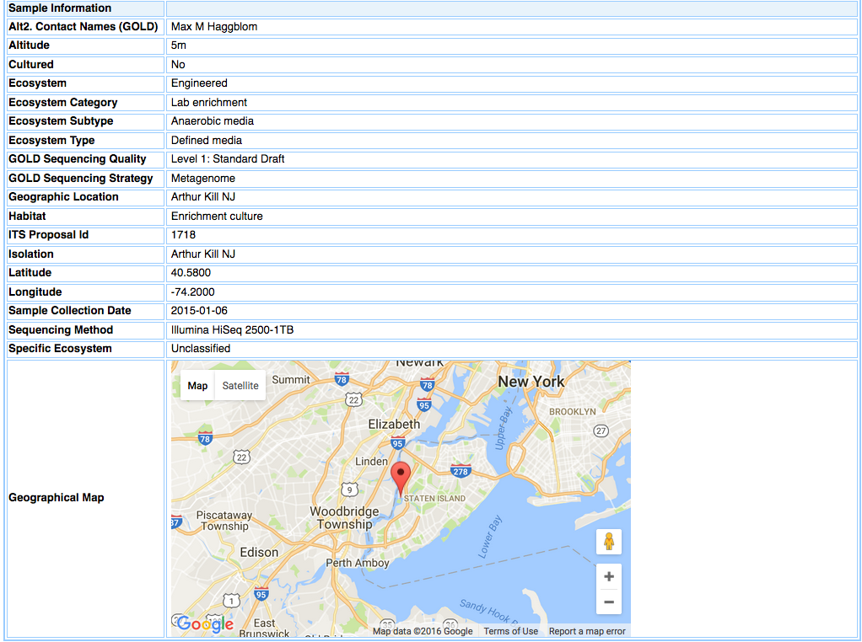
Live Demo

Slide 11
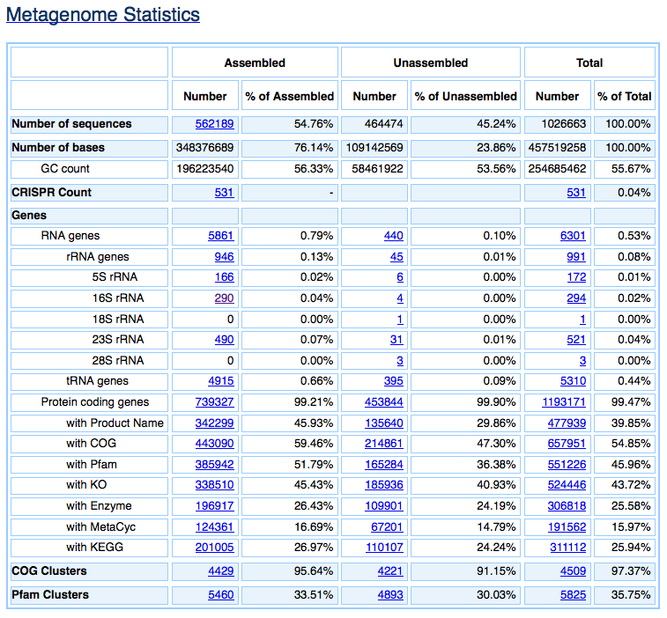
Live Demo
Scaffold Distribution:
Gene Count
Sequence Length
CRISPR information
Ribosomal genes:
rRNA information
tRNA genes
Protein coding genes:
Functional annotation information

Slide 12
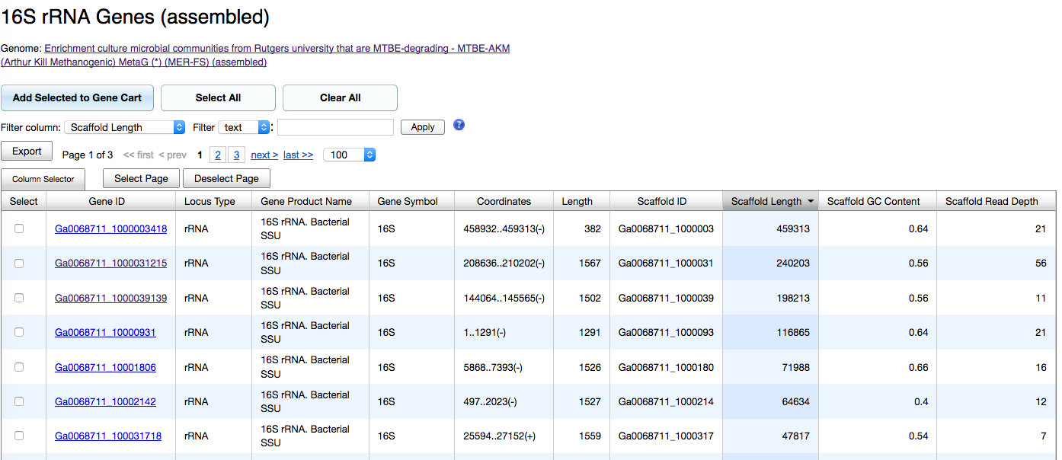
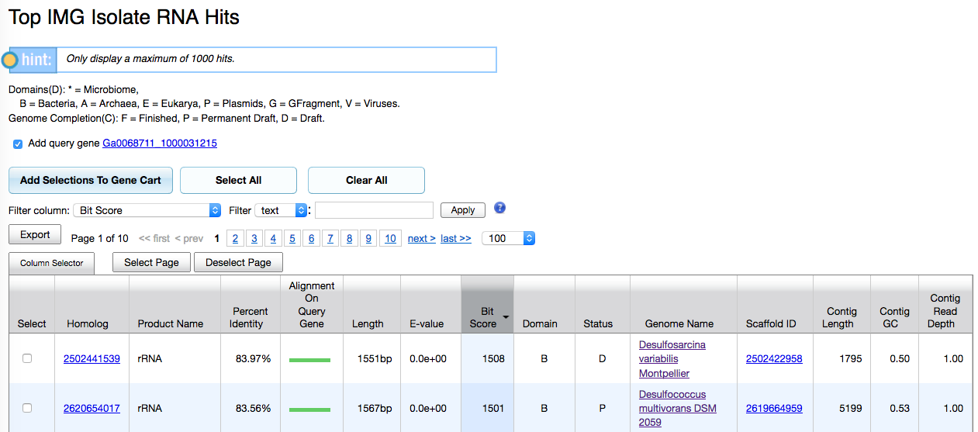
Live Demo
Ribosomal genes:
rRNA information
Search for rRNA across isolate genomes or metagneomes

Slide 13
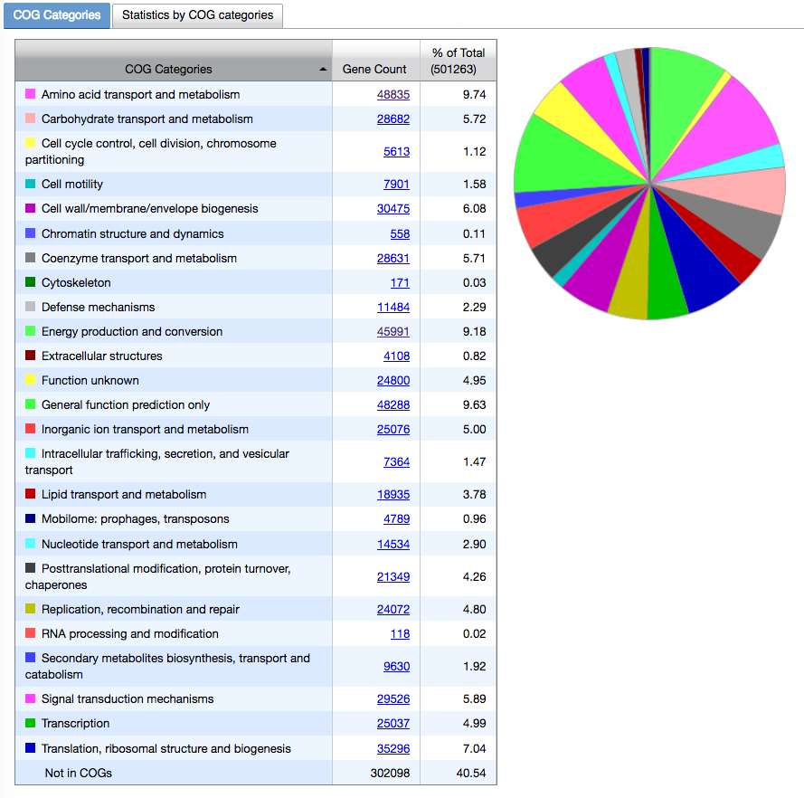
Live Demo
Protein coding genes:
Functional annotation information

Slide 14
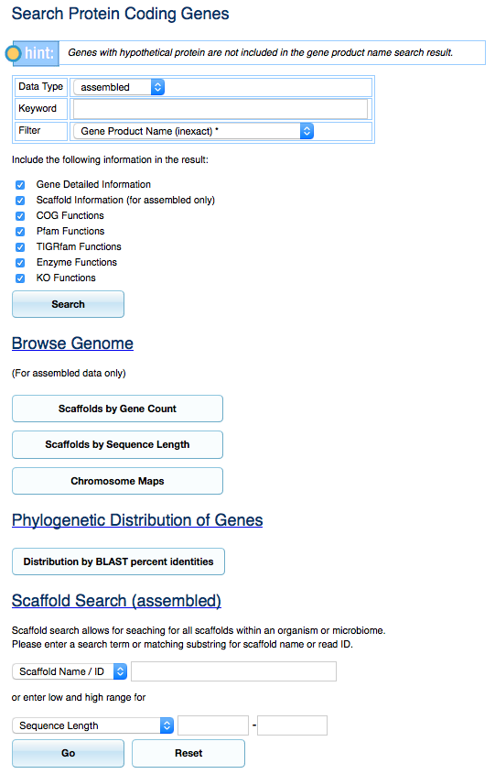
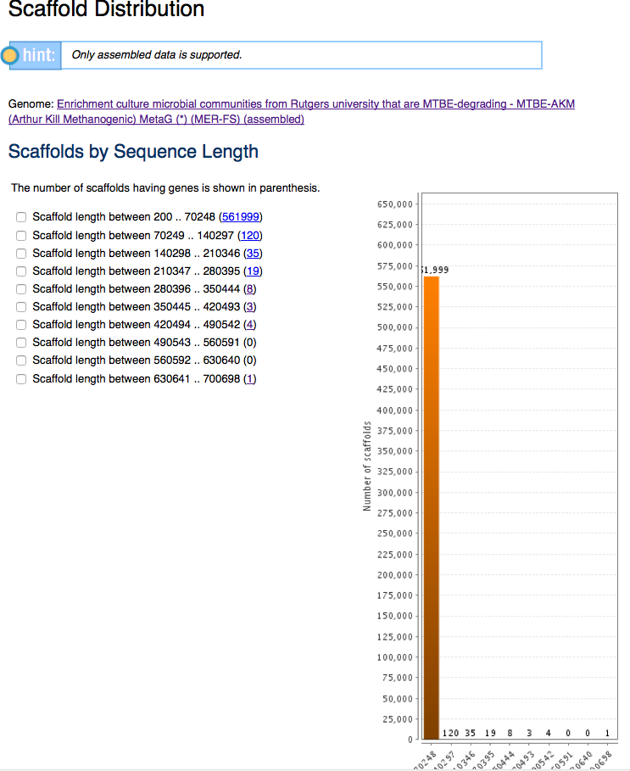
Live Demo

Slide 15
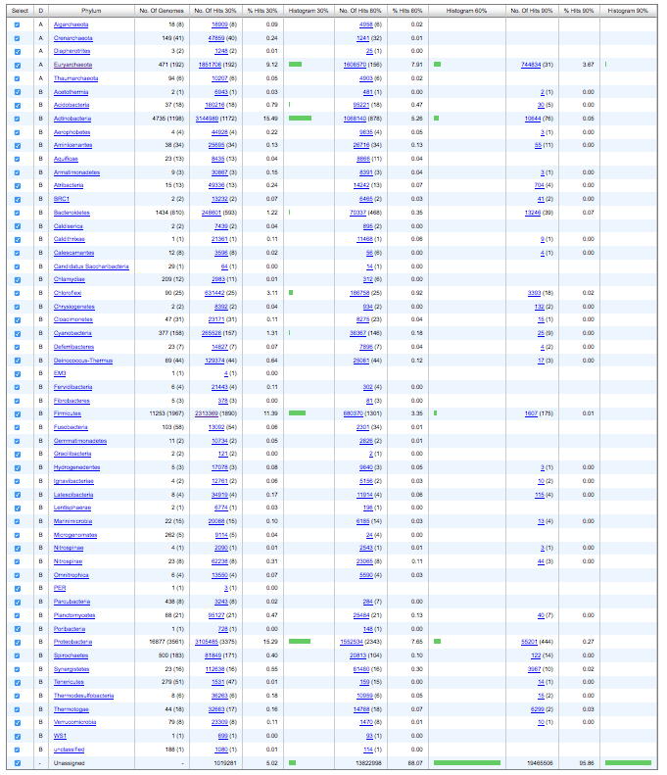
Live Demo
Euryarchaeota
Actinobacteria
Chloroflexi
Firmicutes
Proteobacteria

Slide 16
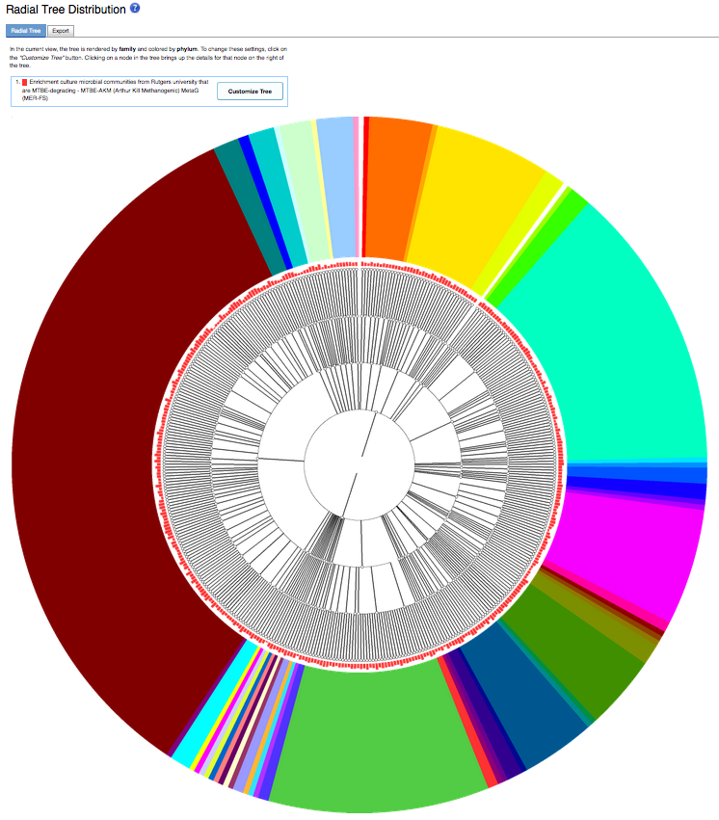
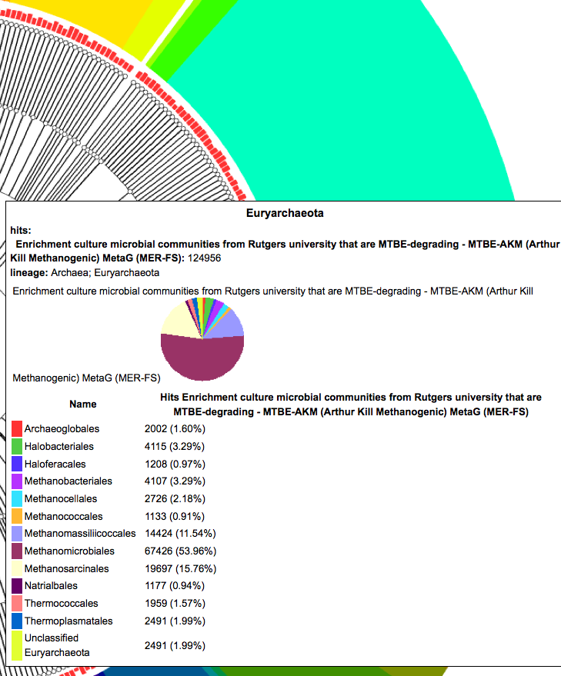
Live Demo

Slide 17
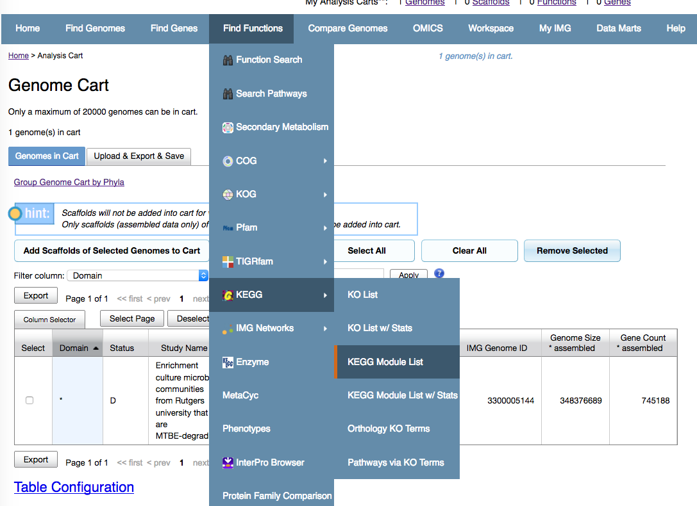
Live Demo

Slide 18
Live Demo
Add functions of interest to cart

Slide 19
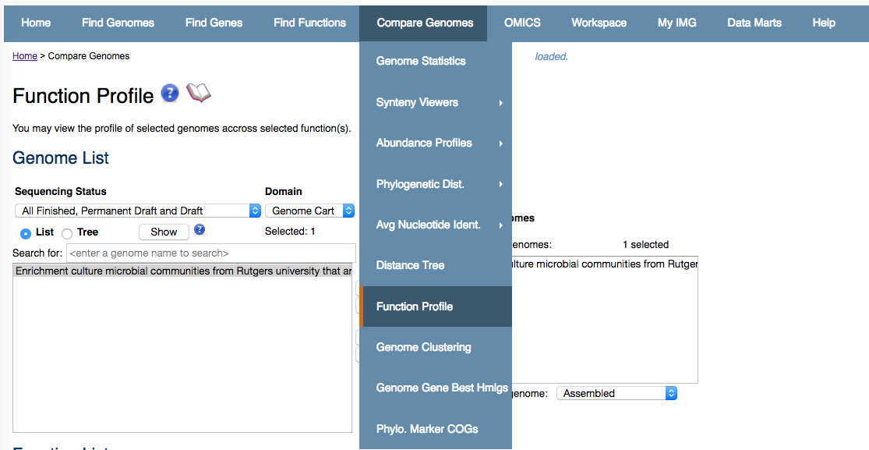
Live Demo
View selected Functions vs. Metagenomes

Slide 20
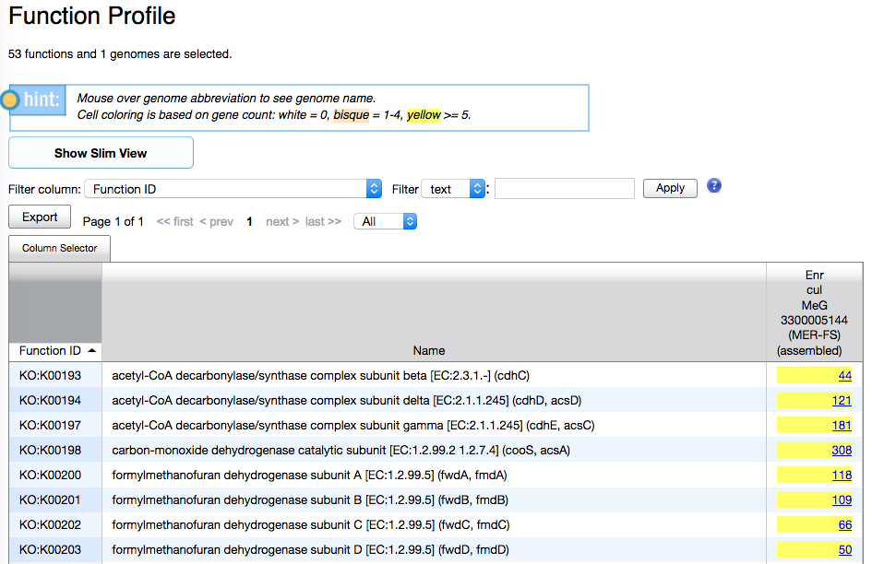
Live Demo
List of genes with KO annotations from metagenome

Slide 21
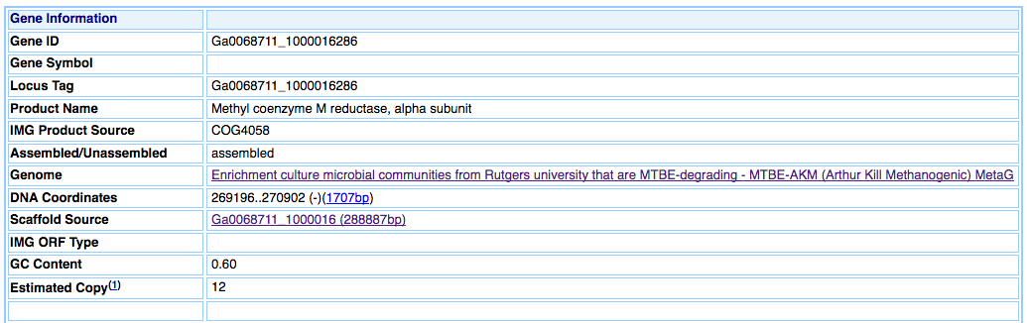
Live Demo
Explore the 86 mcrA genes in the metagenome

Slide 22
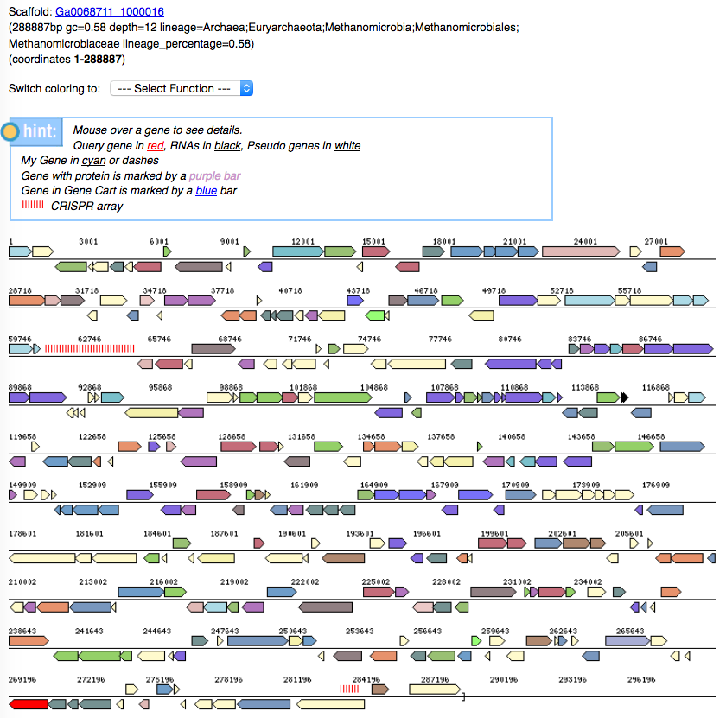
Live Demo
One of the mcrA genes in on a long contig with taxonomic assignment Methanomicrobiaceae

Slide 23
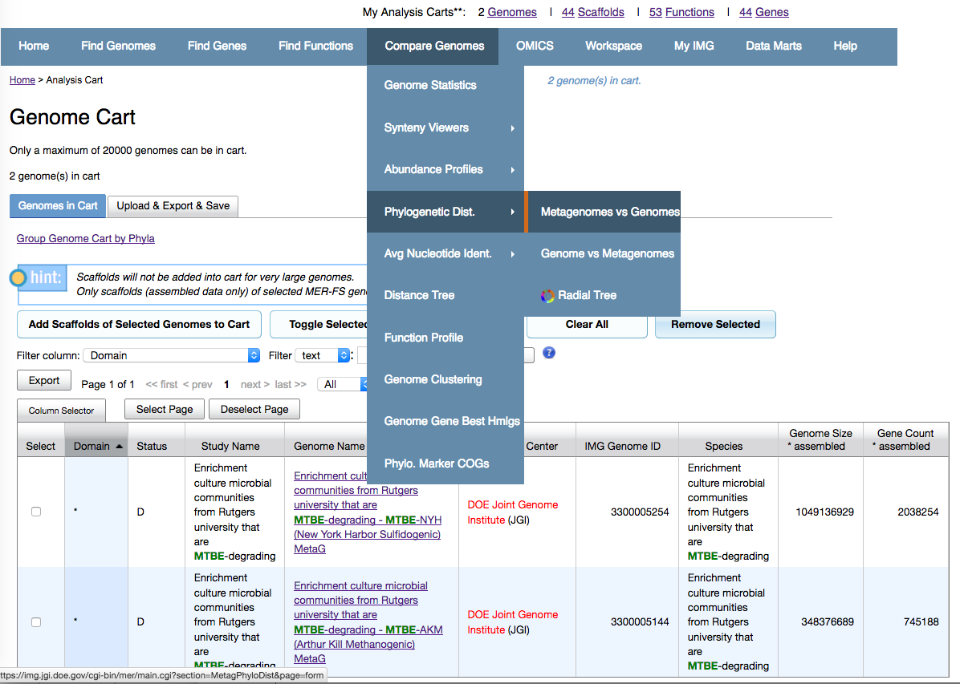
Live Demo
Compare taxonomic profile across two metagenomes

Slide 24
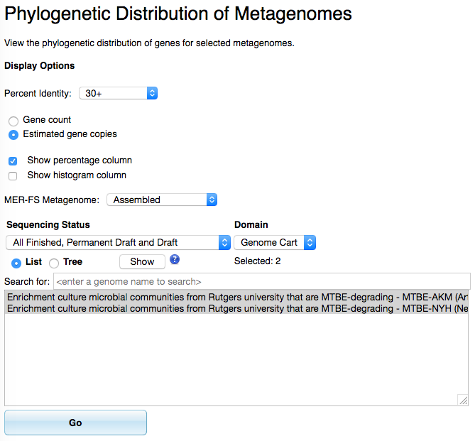
Live Demo
Compare taxonomic profile across two metagenomes

Slide 25
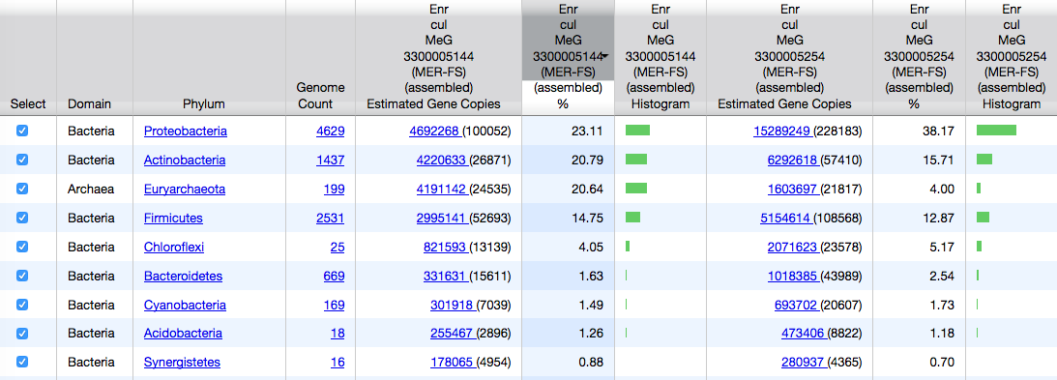
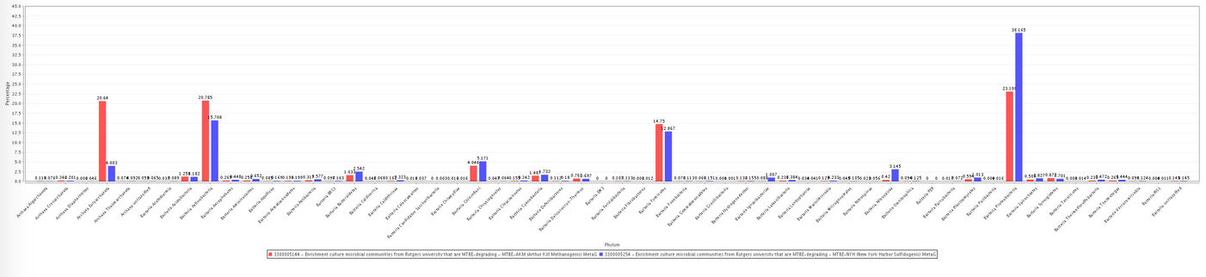
Live Demo

Slide 26
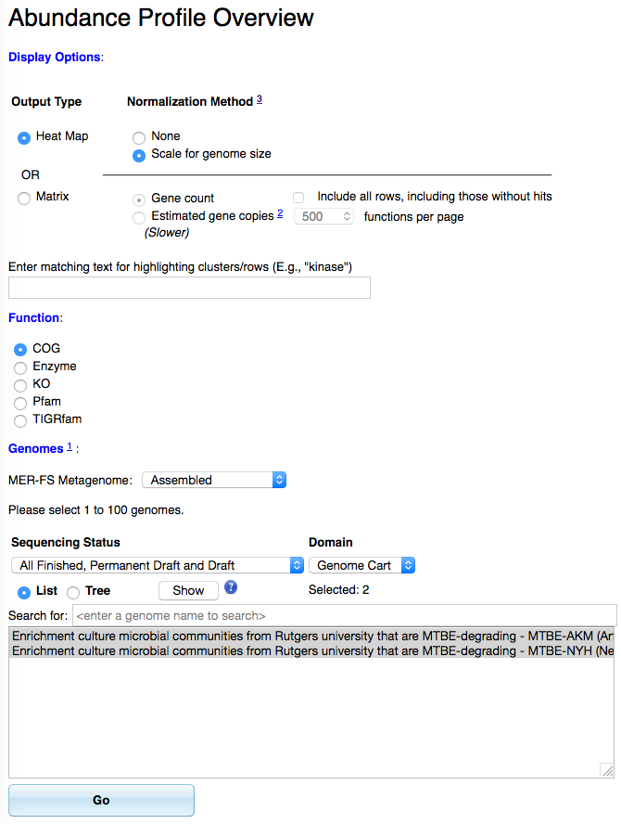
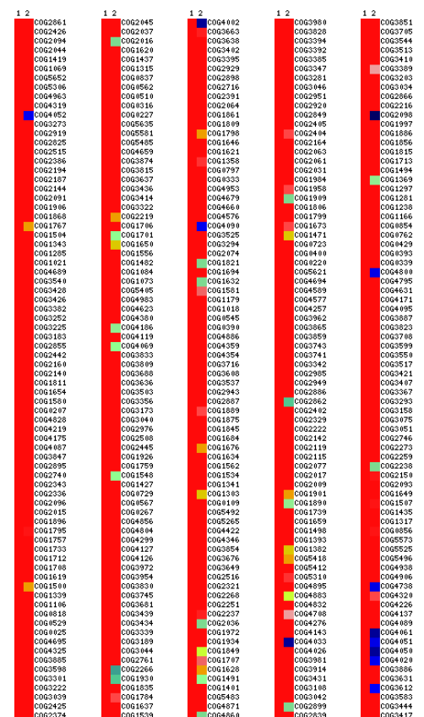
Live Demo
Display overview of normalized function abundance profile (heatmap or matrix)

Slide 27
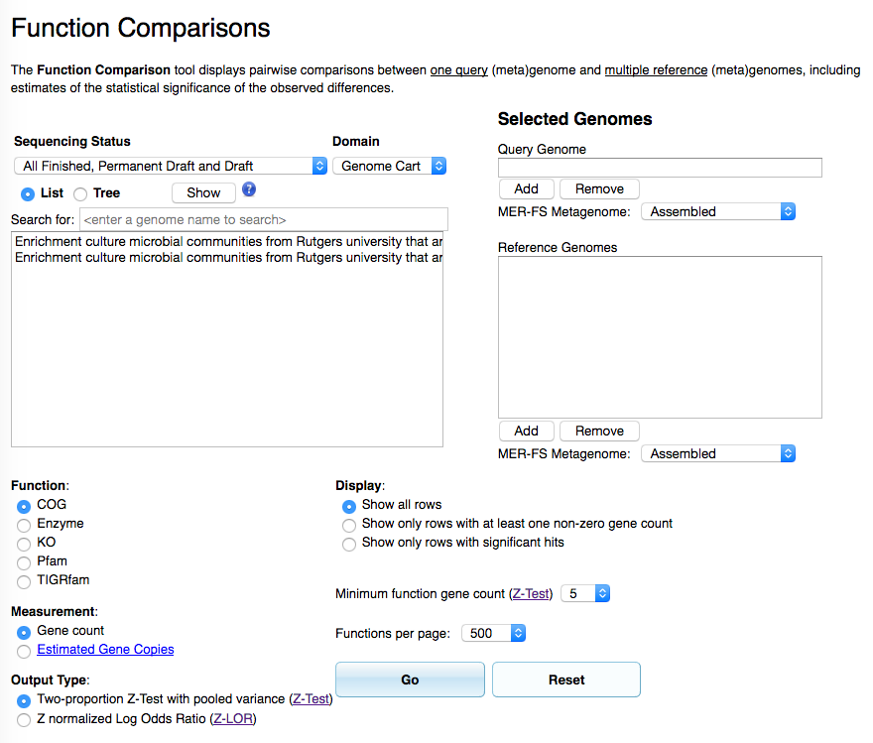
Live Demo
Perform pairwise comparisons with estimates of statistical significance

Slide 28
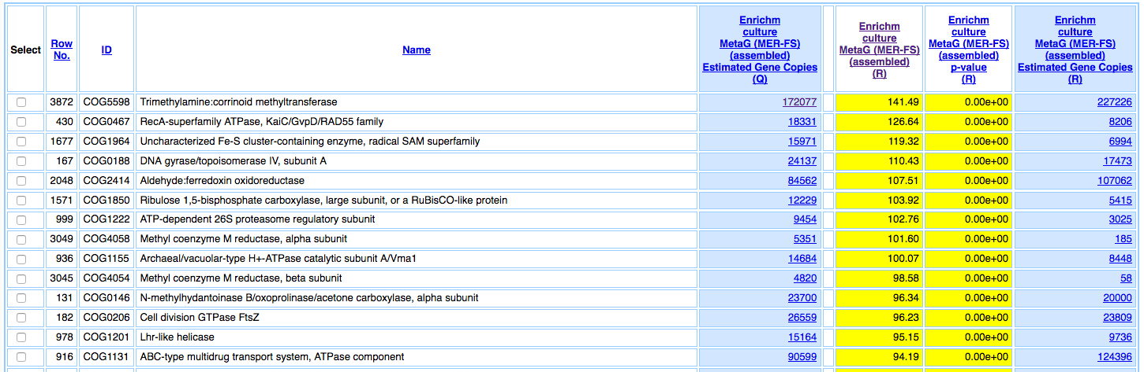
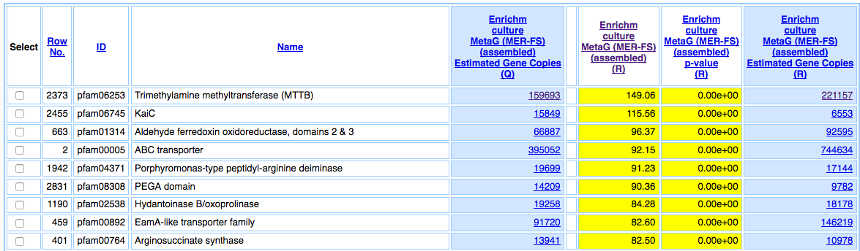
Live Demo

Slide 29
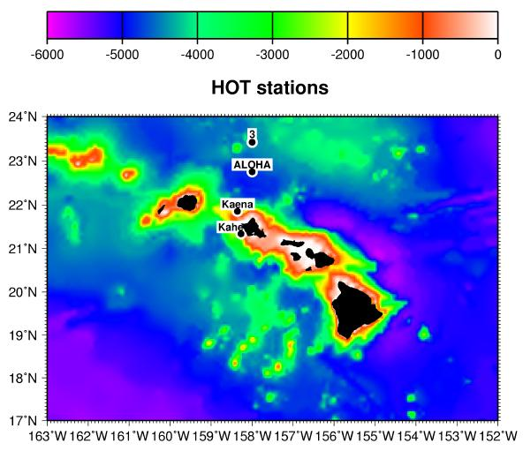
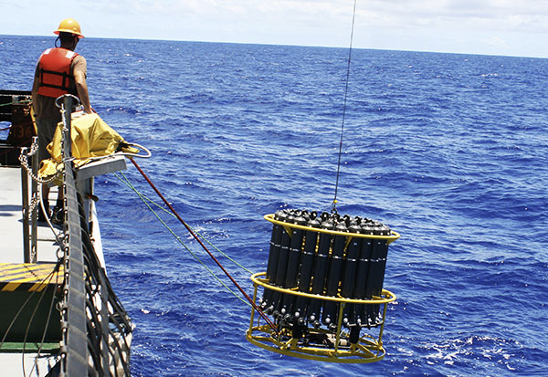
Case Study: Depth profile at St. ALOHA

Slide 30
Case Study: Depth profile at St. ALOHA
First study to look at the genomic potential of depth-stratified microbial communities

Slide 31
Case Study: Depth profile at St. ALOHA
Differences in taxonomic distribution
PZ: Prochlorococcus, Pelagibacter (SAR11)
DW: Chloroflexi, Planctomycetes

Slide 32
Case Study: Depth profile at St. ALOHA
Partitioning of microbial communities based on depth

Slide 33
Case Study: Depth profile at St. ALOHA
Objectives:
Identify 7 metagenomes from this study
Quick Genome search
Metadata search operations
Compare multiple metagenomes
Hierarchical clustering by Function & Taxonomy
Ordination (PCA, PCoA and NMDS)
Correlation matrix

Slide 34
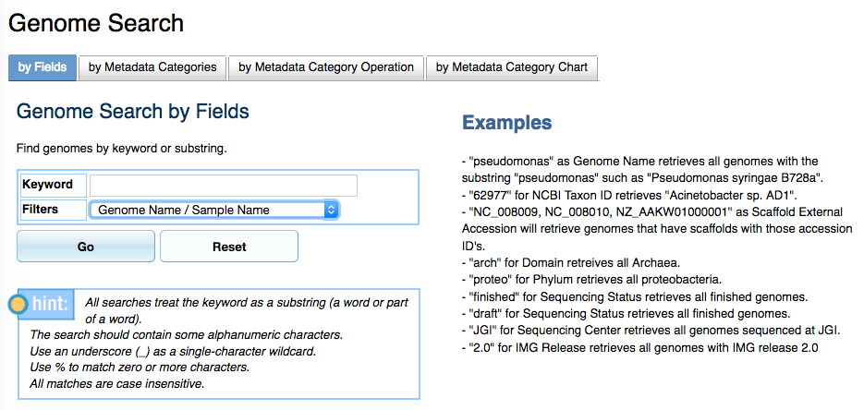
Case Study: Depth profile at St. ALOHA

Slide 35
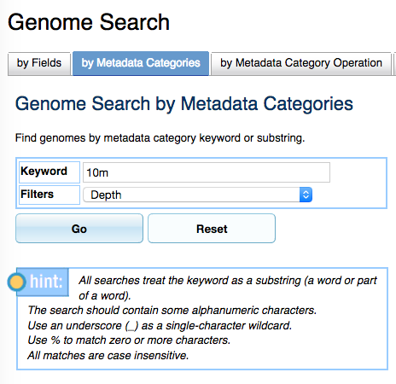
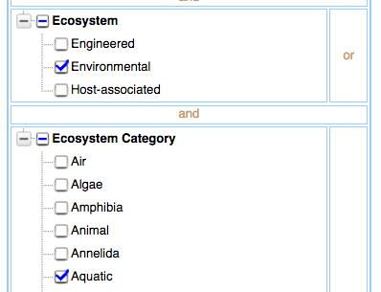
Case Study: Depth profile at St. ALOHA
Metadata search operations
Search by metadata categories (Depth → 10m)
Search by metadata category operation (Ecosystem: Environmental; Ecosystem Category: Aquatic; Ecosystem Type: Marine; Ecosystem Subtype: Oceanic)

Slide 36
Case Study: Depth profile at St. ALOHA
Comparing metagenomes: Ordination Methods
Principal Component Analysis (PCA):
eigenvector technique that attempts to explain as much variance as possible on a series of orthogonal vectors transformed from a set of observations (functions or taxa) using Euclidean distances
Principal Coordinates Analysis (PCoA):
eigenvector technique based on a distance or dissimilarity matrix (Bray-Curtis dissimilarity coefficient), not based on a linear function as in PCA
Non-metric Multidimensional Scaling(NMDS):
iterative distance based (not eigenvalue based) ordination technique that preserves the rank order correlation between objects and attempts to minimize the “stress” (distances among objects that best reflects their compositional dissimilarity; generally < 0.2 is a good representation)

Slide 37
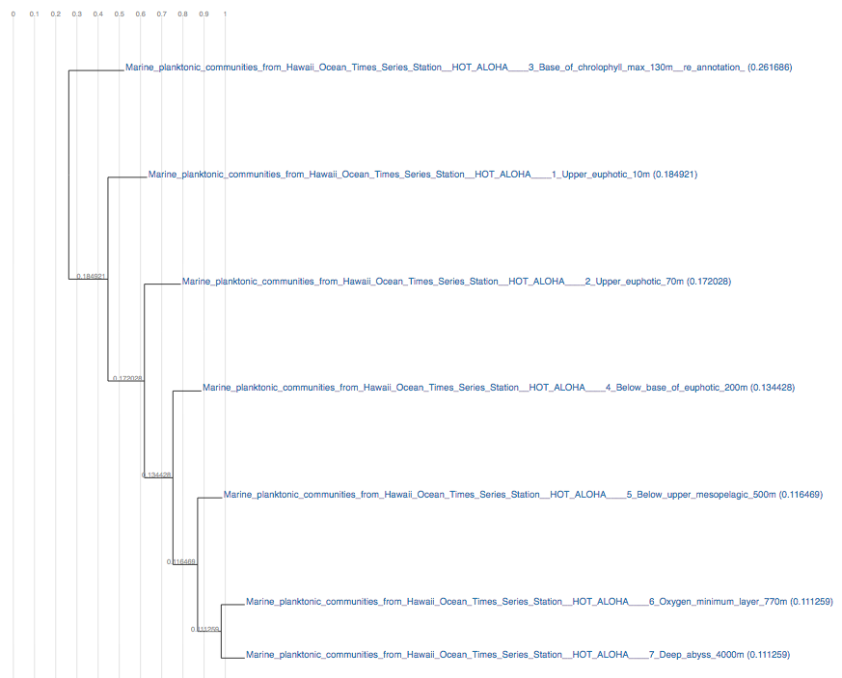
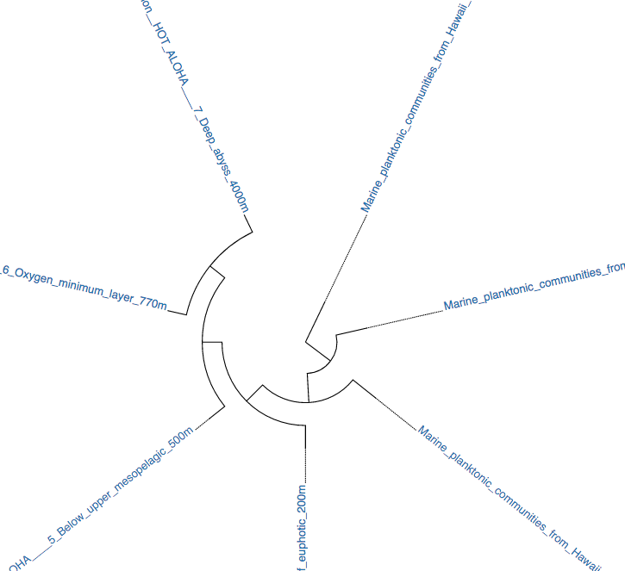
Case Study: Depth profile at St. ALOHA
Hierarchical clustering by Function & Taxonomy
Radial or rectangular dendogram views

Slide 38
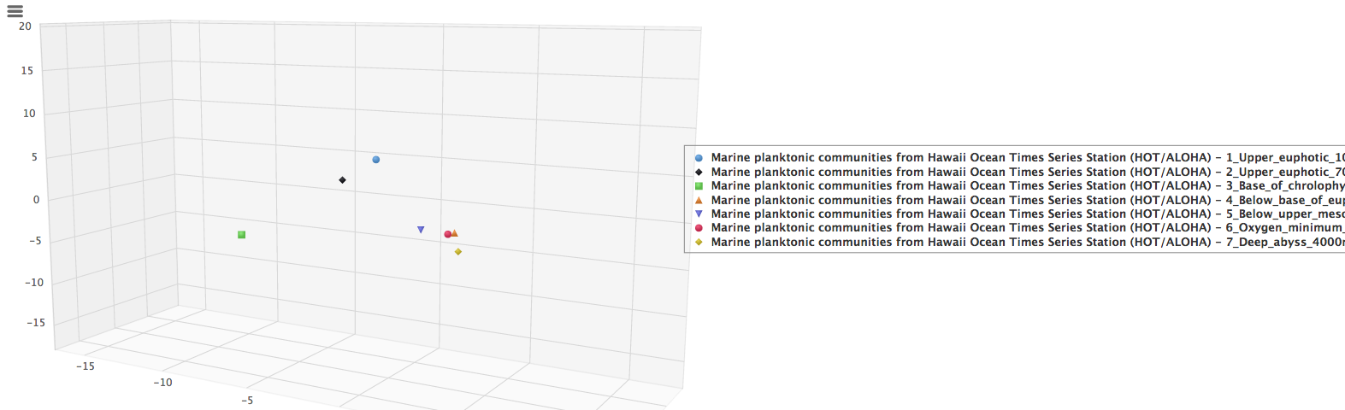
Case Study: Depth profile at St. ALOHA
PCA plot using COGs

Slide 39
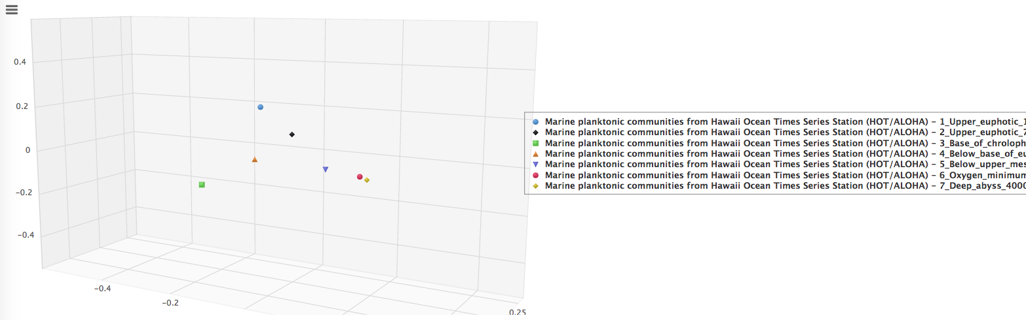
Case Study: Depth profile at St. ALOHA
PCoA plot using COGs

Slide 40
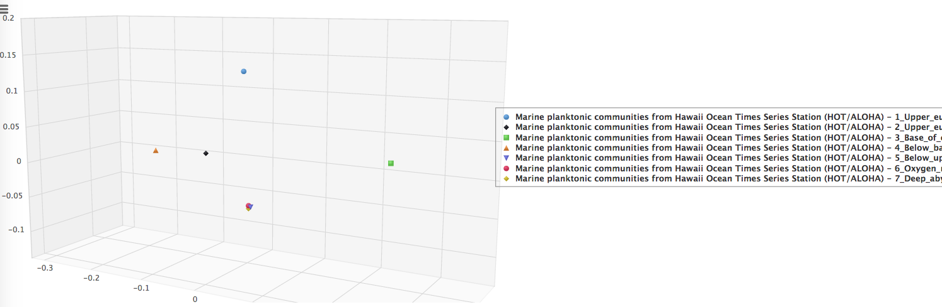
Case Study: Depth profile at St. ALOHA
NMDS plot using COGs

Slide 41
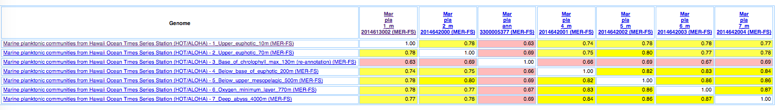
Case Study: Depth profile at St. ALOHA
Correlation Matrix (Pearson Coefficient)

